Slide 1
ARG Matching and Modeling

Slide 2


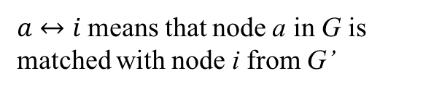

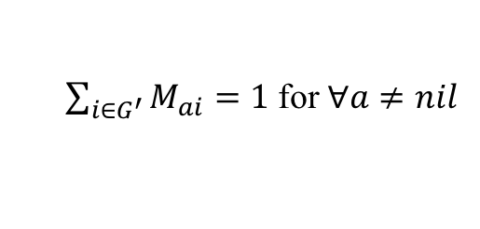
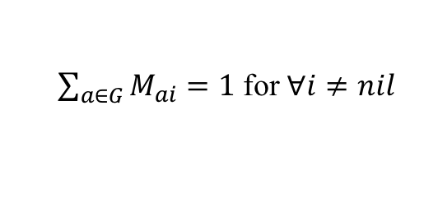
Mathematic Formulation
The energy of matching two ARGs $G$ and $G^{′}$ is defined as
$$E\left(G,G^{′},M\right)=−\frac{1}{2}\sum_{a∈G}{\sum_{b∈G}{\sum_{i∈G^{′}}{\sum_{j∈G^{′}}{M_{ai}M_{bj}C(a↔i,b↔j)}}}}−α\sum_{a∈G}{\sum_{i∈G^{′}}{M_{ai}C(a↔i)}}$$
Subject to:
$$M≥0$$
Both G and G’ contain a nil node.
$\sum_{i∈G^{′}}{M_{ai}}=1$ for $∀a≠nil$
$a↔i$ means that node a in G is matched with node i from G’
$\sum_{a∈G}{M_{ai}}=1$ for $∀i≠nil$
$$C\left(a↔i,a↔i\right)=0$$
$$C\left(a↔i,b↔j\right)=C\left(b↔j,a↔i\right)$$

Slide 3
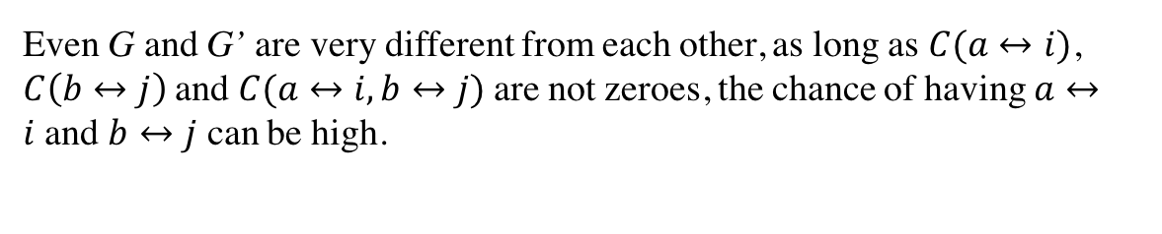
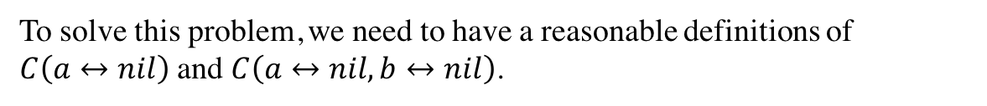
The Problem
G
a
b
nil
G’
i
j
nil
Even G and G’ are very different from each other, as long as $C(a↔i)$, $C\left(b↔j\right)$and $C(a↔i,b↔j)$are not zeroes, the chance of having $a↔i$and $b↔j$ can be high.
To solve this problem, we need to have a reasonable definitions of $C\left(a↔nil\right)$ and $C\left(a↔nil,b↔nil\right)$.

Slide 4
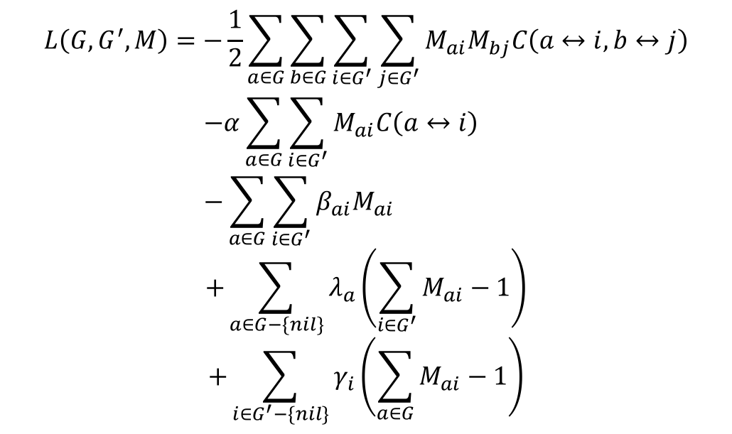
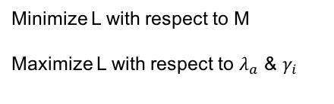
Solve Graph Matching
Use Lagrange multipliers to incorporate the constraints into the cost function.
$$L\left(G,G^{′},M\right)=−\frac{1}{2}\sum_{a∈G}{\sum_{b∈G}{\sum_{i∈G^{′}}{\sum_{j∈G^{′}}{M_{ai}M_{bj}C\left(a↔i,b↔j\right)}}}}$$
$$−α\sum_{a∈G}{\sum_{i∈G^{′}}{M_{ai}C\left(a↔i\right)}}$$
$$−\sum_{a∈G}{\sum_{i∈G^{′}}{β_{ai}M_{ai}}}$$
$$+\sum_{a∈G−\{nil\}}{λ_{a}\left(\sum_{i∈G^{′}}{M_{ai}}−1\right)}$$
$$+\sum_{i∈G^{′}−\{nil\}}{γ_{i}\left(\sum_{a∈G}{M_{ai}}−1\right)}$$
Minimize L with respect to M
Maximize L with respect to $λ_{a}$ & $γ_{i}$

Slide 5
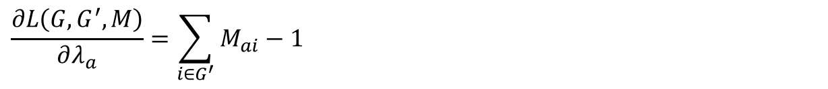
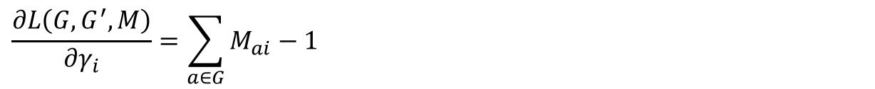
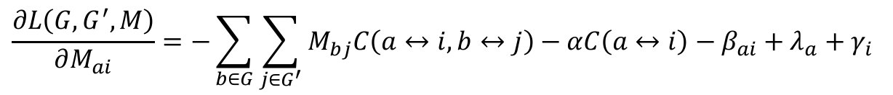
Gradient Function
$$\frac{∂L\left(G,G^{′},M\right)}{∂M_{ai}}=−\sum_{b∈G}{\sum_{j∈G^{′}}{M_{bj}C\left(a↔i,b↔j\right)}}−αC\left(a↔i\right)−β_{ai}+λ_{a}+γ_{i}$$
$$\frac{∂L\left(G,G^{′},M\right)}{∂λ_{a}}=\sum_{i∈G^{′}}{M_{ai}}−1$$
In Theano, this step can be voided as it can do derivation for us
$$\frac{∂L\left(G,G^{′},M\right)}{∂γ_{i}}=\sum_{a∈G}{M_{ai}}−1$$

Slide 6
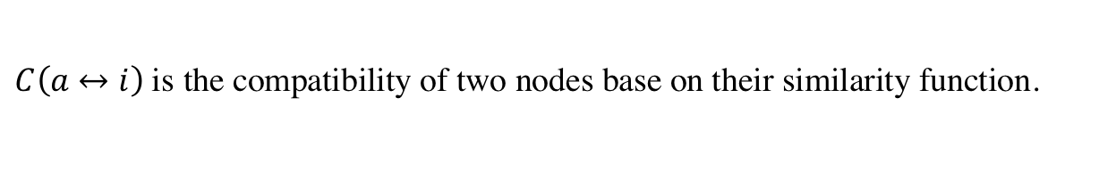
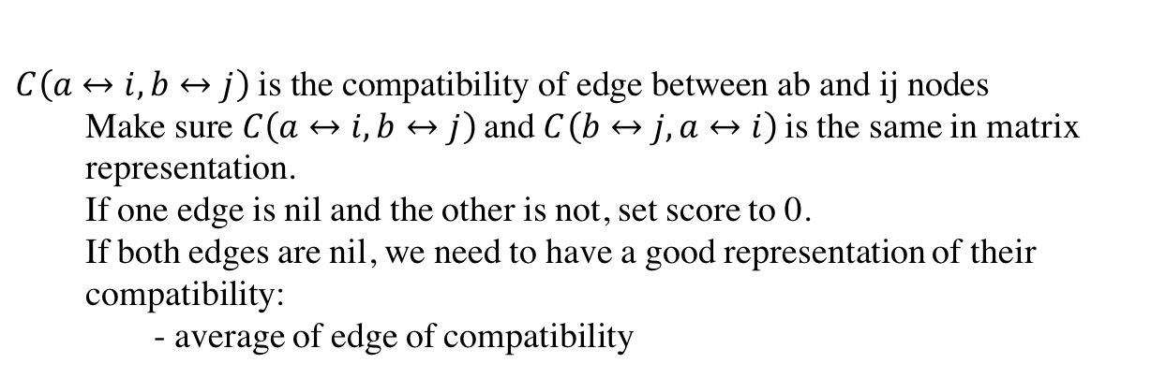
Compatibility Function
$$C\left(a↔i\right) \text{is} \text{the} \text{compatibility} \text{of} \text{two} \text{nodes} \text{base} \text{on} \text{their} \text{similarity} \text{function}\text{.}$$
$$C\left(a↔i, b↔j\right) \text{is} \text{the} \text{compatibility} \text{of} \text{edge} \text{between} \text{ab} \text{and} \text{ij} \text{nodes}$$
$\text{Make} \text{sure} C\left(a↔i, b↔j\right)$ $\text{and}$ $C\left(b↔j, a↔i\right)$ is the same in matrix representation.
If one edge is nil and the other is not, set score to 0.
If both edges are nil, we need to have a good representation of their compatibility:
- average of edge of compatibility

